Slide 1
District-Level Market Attractiveness Index (MAI)
A Machine Learning Framework for Optimizing Pharmaceutical Resource Allocation
Strategic Expansion and Territory Planning in India
Prepared for Sun Pharma Evaluation Panel
Notes:
Good morning, panel. Today I am presenting a comprehensive, data-driven framework designed to solve a critical challenge for Sun Pharma: How do we objectively rank and prioritize over 600 diverse Indian districts to maximize commercial ROI across different therapy lines?

Slide 2
Executive Summary
The Challenge: India’s immense socio-economic diversity makes relying on historical sales insufficient for growth.
The Solution: An algorithmic Market Attractiveness Index (MAI) utilizing a robust Machine Learning data pipeline.
The Output: Three distinct indices (Overall, Chronic, Acute) guiding highly targeted, therapy-specific deployment.
Notes:
At its core, this project bridges the gap between raw government datasets and corporate strategy. By using Principal Component Analysis, we’ve created a scoring system that tells us not just where the people are, but where the relevant purchasing power and disease burden intersect.

Slide 3
Business Objectives & Strategic Imperatives
Precision Resource Allocation: Optimize Medical Representative (MR) deployment based on mathematical viability.
Segmented Therapy Strategy: Decouple sales strategies for Acute (volume) and Chronic (value) drug portfolios.
Predictive Opportunity: Identify 'hidden gem' districts with rising economic and epidemiological trends.
Notes:
We are moving from reactive territory management to predictive market capitalization. If Sun Pharma is launching a new daily diabetes pill, this model tells us exactly which districts to target first.

Slide 4
Market Attractiveness Index (MAI) – Core Definition
A composite, standardized score (0 to 100) quantifying the commercial potential of a district.
Normalizes disparate metrics (GDP vs. Disease Prevalence) into a unified business score.
Drives investment prioritization: Score 95 = Tier-1 priority; Score 35 = Lean distribution approach.
Notes:
Think of the MAI as a financial credit score, but for pharmaceutical markets. It takes completely different units of measurement and synthesizes them into a single, undeniable metric of commercial readiness.

Slide 5
1. Overall Pharmaceutical MAI
Represents a holistic, blended view of a district's total healthcare capacity and wealth.
Captures both short-term volume potential and long-term value potential.
Used for broad footprint planning and determining regional distribution hubs (C&F agents).
Notes:
The Overall MAI is our macro-lens. If Sun Pharma wants to know the absolute strongest overarching markets in India, regardless of the specific drug, this index provides that 30,000-foot view.

Slide 6
2. Chronic Therapy MAI
Targets commercial viability for daily, recurring medications (cardiovascular, anti-diabetic).
Heavily dependent on Purchasing Power (GDP), Specialized Infrastructure, and Lifestyle Disease indicators.
Guides deployment of highly specialized senior MRs to wealthy, urbanized districts.
Notes:
Chronic therapies require patients who can afford to buy medication every month for life. Therefore, this index aggressively weighs district wealth and specific epidemiological data over sheer population volume.

Slide 7
3. Acute Therapy MAI
Maximizes volume, reach, and immediate care for short-term medications (antibiotics, pain management).
Relies on total population mass, younger demographics, and basic healthcare facility volume.
Guides mass-market distribution strategies focusing on pharmacies and general physicians.
Notes:
Acute therapies are a numbers game. You don't need a high GDP to sell an antibiotic; you need a large population and high foot traffic in local clinics.

Slide 8
Variable Selection: Economic Indicators
Average GDP & Per Capita Wealth: Direct indicators of out-of-pocket healthcare purchasing power.
Literacy Rates: Correlates strongly with health awareness and proactive medical seeking behavior.
Rationale: Wealthier districts can sustain high-margin chronic portfolios.
Notes:
We included economic indicators because in India, a significant portion of healthcare spending is out-of-pocket. GDP serves as a proxy for a district's ability to absorb premium, branded generics.

Slide 9
Variable Selection: Infrastructure Readiness
Total Healthcare Facilities: Measures the physical capacity for diagnosis and prescription.
Public vs. Private Ratios: Indicates the level of premium healthcare access.
Rationale: You cannot sell specialized drugs if the district lacks the clinics to prescribe them.
Notes:
Infrastructure is the bottleneck of pharma sales. We mapped facility density to ensure our model doesn't recommend a district where patients have no physical access to doctors.

Slide 10
Variable Selection: Epidemiological Data
Blood Sugar & Blood Pressure Levels: Directly maps to anti-diabetic and cardiovascular portfolios.
Tobacco Use & Age Demographics: Predicts respiratory and generalized acute illness patterns.
Rationale: Replaces 'gut feeling' with verified public health statistics.
Notes:
This is where the model gets highly specific. We utilized gender-segmented health data to understand the exact underlying disease burden, allowing for hyper-targeted product launches.

Slide 11
Contrasting Drivers: Acute vs. Chronic
Chronic Drivers: High GDP, High Literacy, High Hypertension rates, Aging population.
Acute Drivers: Total Population density, High clinic counts, Younger demographics.
Business Impact: Prevents misallocating expensive resources into low-yield territories.
Notes:
By separating these variables, we proved that the best market for an antibiotic is rarely the best market for a premium heart medication. The drivers are fundamentally different.

Slide 12
Methodology: Data Pipeline & Preparation
Data Sourcing: Aggregated from verified government health and economic repositories.
Data Engineering: Merged distinct regional datasets using Python (Pandas).
Transformation: Engineered new features to represent per-capita ratios rather than raw counts.
Notes:
Our methodology strictly adheres to data engineering best practices. We built a scalable Pandas pipeline that seamlessly joins disparate demographic and health tables based on district codes.

Slide 13
Methodology: Handling Missing Data
Challenge: Real-world government data contains gaps and null values.
Solution: Implemented SimpleImputer using Median Imputation.
Why Median?: Prevents statistical skewing caused by extreme outliers in wealth or population.
Notes:
Missing data can break a machine learning model. Instead of deleting rows and losing valuable districts, we used median imputation to safely preserve the statistical integrity of the dataset.

Slide 14
Methodology: Normalization Strategy
The Issue: Comparing GDP (billions) with disease prevalence (percentages) creates scale imbalances.
The Fix: Applied StandardScaler (Z-score normalization).
The Result: Every variable is converted to a standard scale, allowing the algorithm to weight them fairly.
Notes:
Without Z-score scaling, our algorithm would only look at GDP because the numbers are so large. Scaling ensures a 5% increase in diabetes is treated just as importantly as a massive GDP.

Slide 15
Methodology: Index Construction (PCA)
Algorithm Used: Principal Component Analysis (PCA).
Process: Extracted the 1st Principal Component to capture maximum variance across all variables.
Final Output: Used MinMaxScaler to convert the complex PCA outputs into a clean 0-100 business score.
Notes:
PCA is the engine of our framework. It mathematically finds the hidden relationships between wealth, infrastructure, and health, compressing them down into the single, powerful MAI score you see on the dashboard.

Slide 16
Methodology: Future Demand Modeling
Population Scaling: Factored in birth rates and age bracket shifts.
Economic Trajectory: Analyzed wealth growth to predict future purchasing power.
Predictive Output: Highlights which districts will age into chronic disease hubs over the next 5 years.
Notes:
We didn't just build a model for 2026; we built a predictive framework. By incorporating demographic shifts, we can tell executives where to establish a foothold before competitors do.

Slide 17
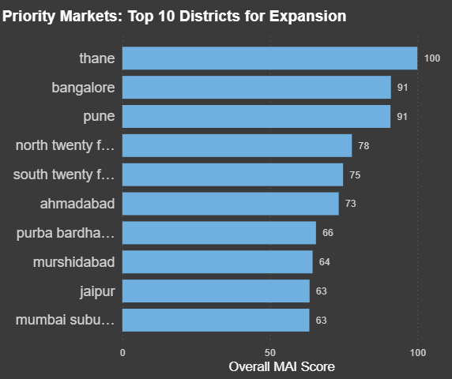
Visual Insights: District Rankings
Format: Top 10 Clustered Bar Chart for immediate priority targeting.
Executive Value: Provides a definitive, rank-ordered 'Hit List' for regional sales directors.
Action: Immediate deployment of senior resources to top decile districts.
Notes:
The Power BI dashboard translates our complex PCA math into immediate action. The Top 10 bar chart gives regional directors exactly what they need: a clear, prioritized list of where to focus their teams.

Slide 18
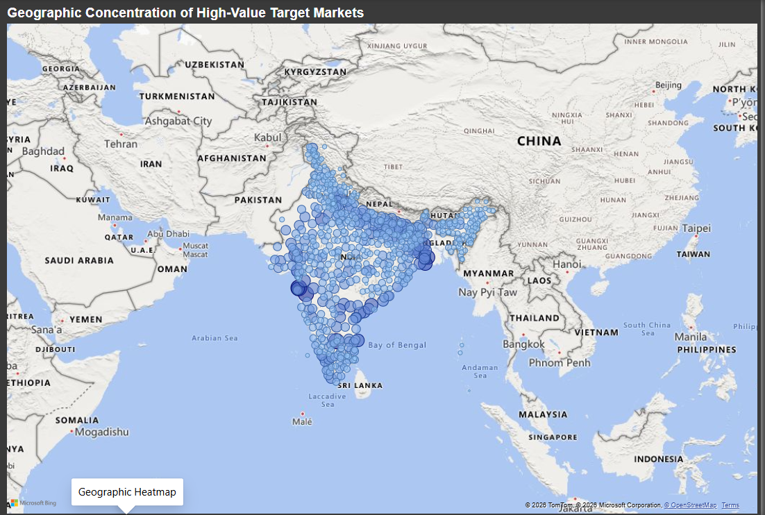
Visual Insights: Geographic Concentration
Format: Geographic Bubble Heatmap across the Indian subcontinent.
Executive Value: Identifies spatial clusters and supply chain hubs.
Action: Optimizes logistics and regional warehousing based on high-density MAI scores.
Notes:
The map visual instantly answers the 'where'. It highlights that high-value markets aren't scattered randomly; they cluster around specific economic corridors, guiding our logistics strategy.

Slide 19
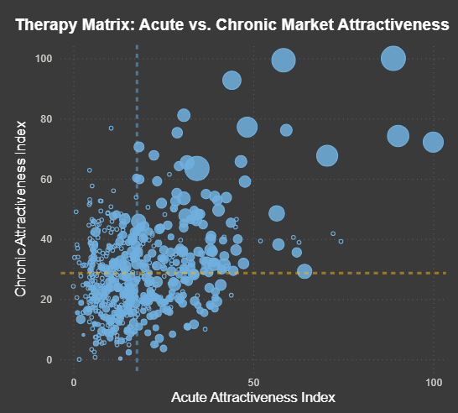
Visual Insights: The Therapy Matrix
Format: Scatter Plot comparing Acute (X-axis) vs. Chronic (Y-axis) MAI scores.
Executive Value: Creates a four-quadrant matrix classifying district typologies.
Action: Identifies 'Gold Mine' districts scoring high in both, vs. niche single-therapy markets.
Notes:
The Therapy Matrix is our most powerful strategic visual. By plotting Acute against Chronic, we immediately spot which districts demand a dual-portfolio approach versus those that only require basic antibiotic distribution.

Slide 20
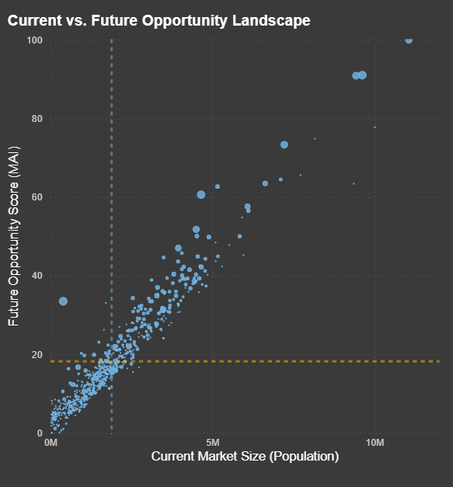
Visual Insights: Current vs. Future Opportunity
Format: BCG-style Matrix (Current Population vs. MAI Score).
Executive Value: Separates mature 'Cash Cow' markets from emerging 'Star' markets.
Action: Balances the portfolio between harvesting current revenue and investing in future growth.
Notes:
This view ensures balanced investment. We can protect our massive legacy markets while aggressively funding expansion into smaller districts that our algorithm identifies as high-growth.

Slide 21
Strategy: Market Prioritization & Territory Planning
Redefines territories based on data-driven potential rather than geographical convenience.
Establishes strict KPIs based on a district's specific MAI baseline.
Eliminates bias in sales targets.
Notes:
With this framework, territory planning is no longer guesswork. We can hold sales teams accountable to mathematically derived KPIs based on the true potential of their assigned district.

Slide 22
Strategy: Sales Force Deployment
High Chronic MAI: Deploy Key Account Managers (KAMs) for specialist doctors.
High Acute MAI: Deploy mass-market MRs for broad pharmacy coverage.
Low MAI / High Pop: Rely on wholesale channel distribution.
Notes:
This ensures we are putting the right talent in the right place. An expensive Key Account Manager should not be deployed to an Acute-heavy market; their skills are best utilized in high-Chronic districts.

Slide 23
Replicability & Scalability
Cross-Therapy: Variables can be swapped (e.g., UV exposure for Dermatology).
Cross-Geography: Python/Power Query architecture applies to any global market data.
Dynamic Weighting: The algorithm adapts automatically to new data inputs.
Notes:
The beauty of this framework is its modularity. If Sun Pharma wants to evaluate South Africa next year, we simply plug the South African census into our Python script, and the model instantly recalculates the strategy.

Slide 24
Conclusion & Next Steps
The MAI transitions Sun Pharma from historical reporting to predictive strategy.
Immediate Next Step: Integrate final Power BI dashboard with CRM deployment systems.
Long-Term Vision: Continuous ML training to refine predictive accuracy year-over-year.
Notes:
In conclusion, the MAI is not just an analytics project; it is a commercial engine. We are ready to integrate these insights directly into the sales CRM. Thank you for your time, I am happy to take any questions.

